Slide 2
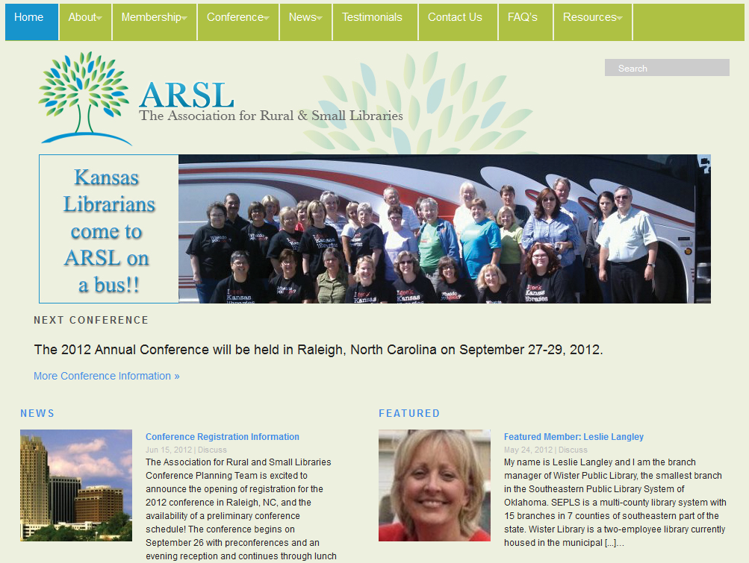

Slide 3
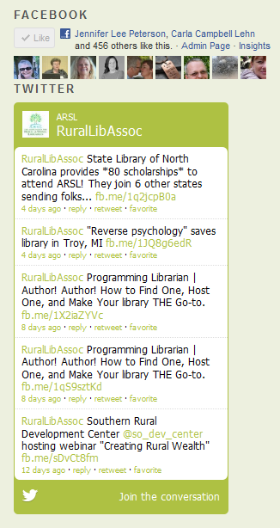
Join Rural Librarians from around the country!

Slide 4
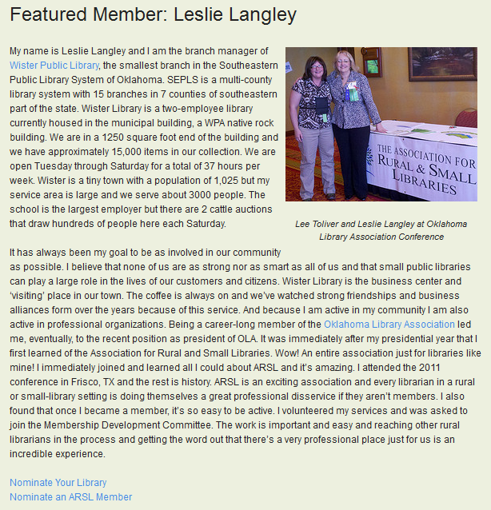

Slide 6
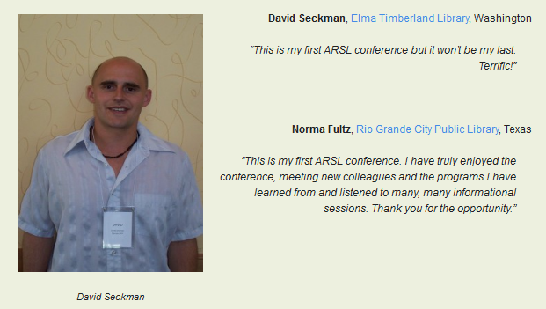

Slide 7
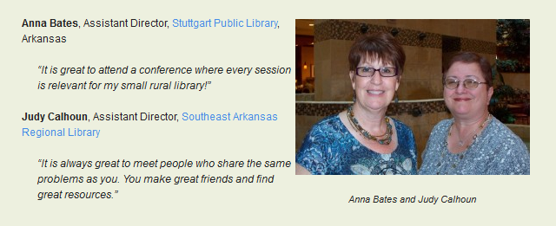

Slide 8
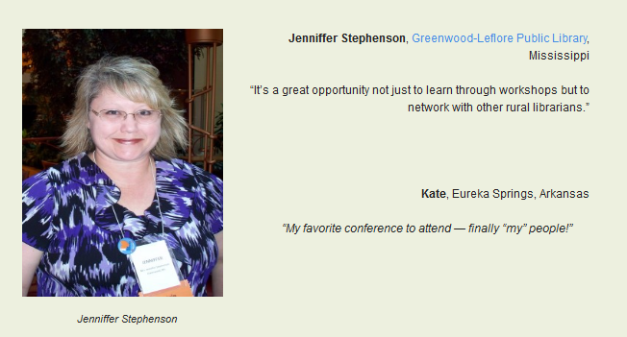

Slide 9
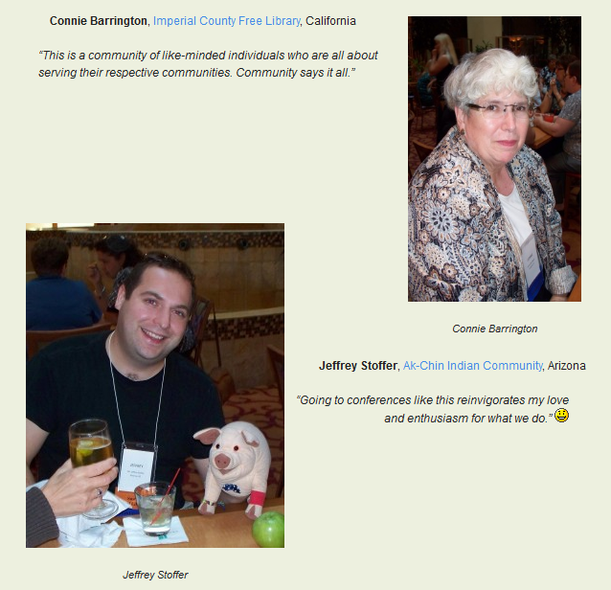

Slide 10
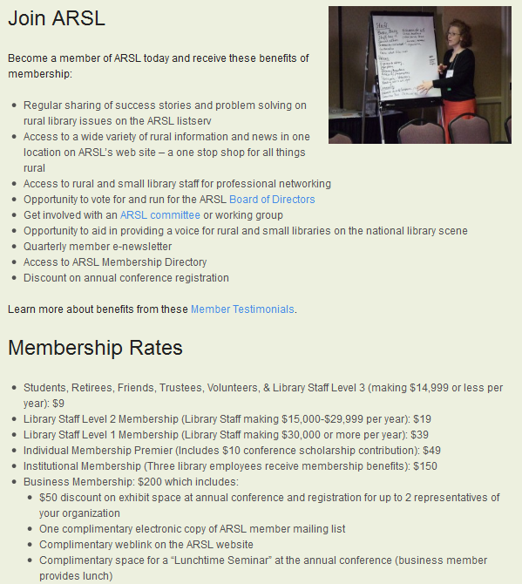

Slide 11
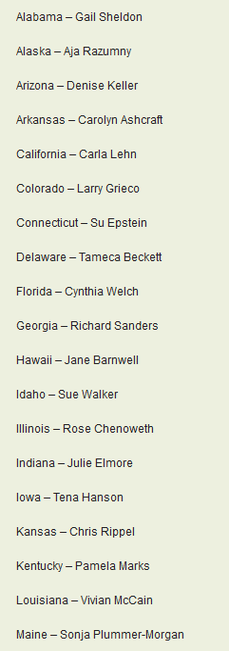
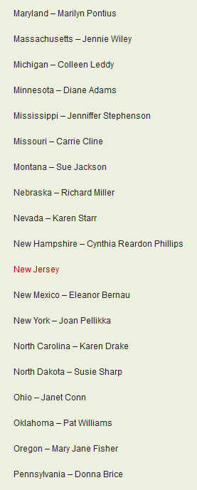
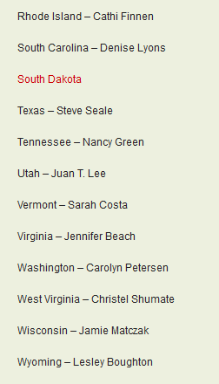
Key Contact in your state

Slide 12
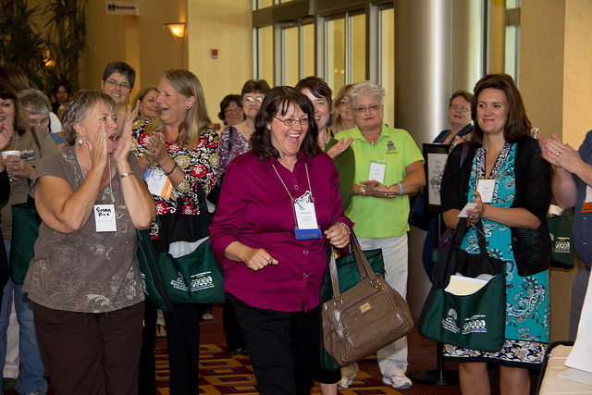

Slide 13
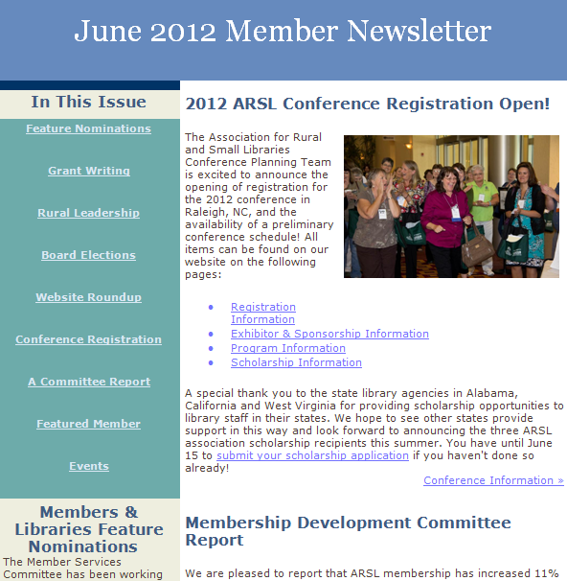

Slide 14
Quarterly Webinars!
Date | Event | Reg | Attend
9/20/2011 | Innovations from America's Best Small Libraries 2011 | 396 | 211
12/14/2011 | A Small But Powerful Webinar for Winning Big Support for Your Rural Library | 488 | 212
3/27/2012 | Adult Programs on a $0 Budget | 997 | 578
6/7/2012 | Best Kept Secret: Marketing the Small & Rural Library | 559 | 268

Slide 15
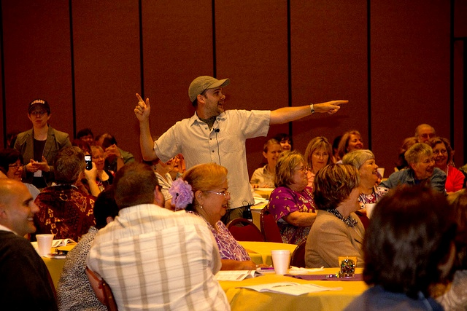

Slide 16
Come join us! http://arsl.info

